Slide 1
Todays Quiz
How far can light (a photon) travel in a vacuum?
Potentially infinitely. Or until it strikes your retina and is absorbed.
https://en.wikipedia.org/wiki/MACS0647-JD

Slide 2

Illumination
Week Two
Radiometry, Photometry & Optical Concepts
A-dec education & training
Christopher Stone August 12, 2020

Slide 3
Radiometric and photometric quantities
Luminosity function V(λ)
Radiometric quantities are not weighted according to the response of the human eye.
Photometric quantities are weighted for a typical human eye response to light.
Reference: Once Innovations, Inc., https://slideplayer.com/slide/1417835/

Slide 4
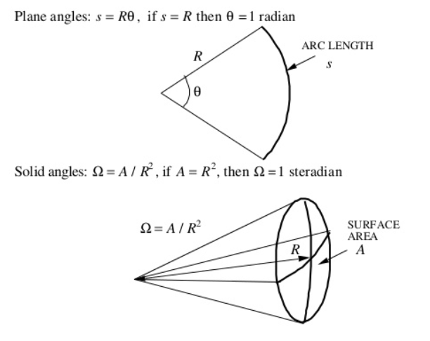
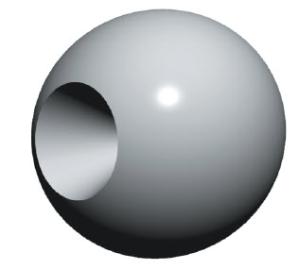
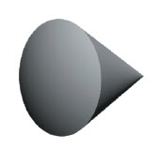

Planar angles and solid angles
$$θ=\frac{s}{R}$$
[radians]
[steradians]

Slide 5
Radiometry
Radiometry is the science of measuring light in any portion of the electromagnetic spectrum. In practice, the term is usually limited to the measurement of infrared, visible and ultraviolet light using optical instruments.
Irradiance, E_{e} is the intensity of light and is measured in watts/m².
Radiance, L_{e}, is the irradiance per unit solid angle. It is measured in W/m²/sr.
Radiant flux or radiant power, Φ_{e,} is the radiant energy emitted, reflected, transmitted or received, per unit time
Radiant intensity, I_{e} is the radiant flux emitted, reflected, transmitted or received, per unit solid angle
https://www.youtube.com/watch?v=gLfYTP4F23g

Slide 6
“Qualitative” illustrations of radiometric quantities
Irradiance, E_{e} [W/m²]
Radiant flux, φ_{e} [W]
Lower E_{e}
Higher E_{e}
Lower φ_{e}
Higher φ_{e}
Radiance, L_{e} [W/m²/sr]
spatially more “dense”
Radiant intensity, I_{e} [W/sr]
directionally more “dense”
Lower I_{e}
Higher I_{e}
Lower L_{e}
Higher L_{e}

Slide 7
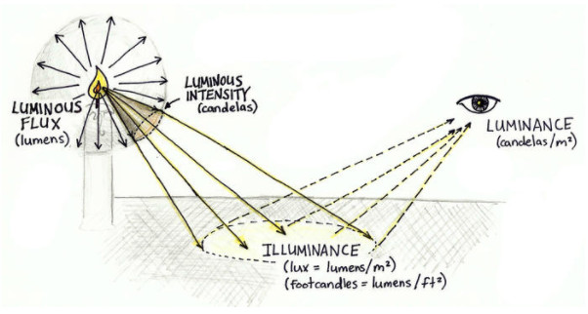
Photometry
Photometry is the science of measuring visible light
Photometry is the science of measuring visible light in units that are weighted according to the sensitivity of the human eye. It is a quantitative science based on a statistical model of the human visual response to light - that is, our perception of light - under carefully controlled conditions. The photometric equivalent of Radiance is called Illuminance and is measured in Lumens per square meter (Lux).

Slide 8
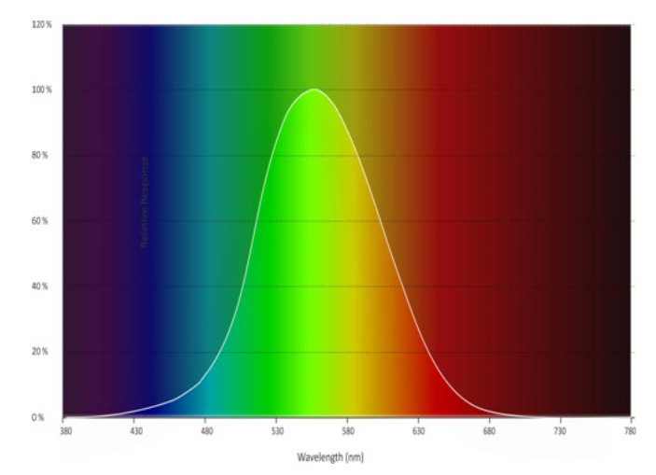
Photopic Luminosity Function, V(λ)
Peak sensitivity at 550 nm

Slide 9
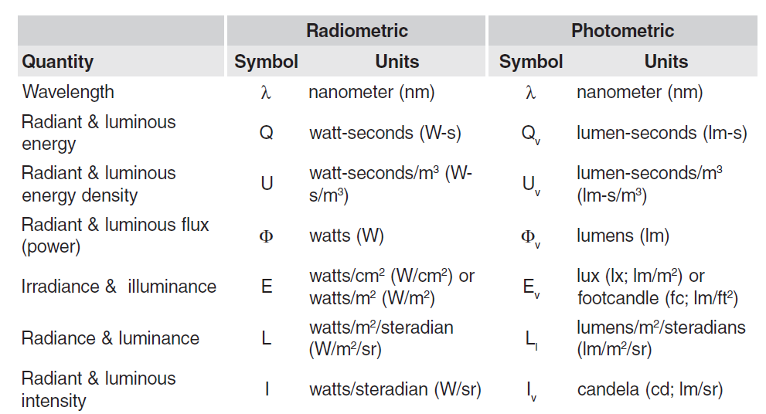

Slide 10
Lumens ‘n’ Lux
Radiant flux or power, F, is the flow rate of radiant energy. It is measured in watts (joules per second). Luminous flux, denoted as F_{v}, is measured in lumens. The CIE defines the lumen in terms of the luminous flux of monochromatic radiation at 555 nm. This definition of the lumen applies to both photopic and scotopic photometry. For other wavelengths, the luminous flux must be weighted by the appropriate photopic or scotopic luminous efficiency function, which is defined in Section 3.2 in Illumination Fundamentals, “Spectral Response.”
Illuminance is the measure of how much is luminous flux is spread over a given area and the unit is Lux. 1 lx= 1 Lumen/m². One can think of illuminance as a measure of the intensity of illumination on a surface.

Slide 11
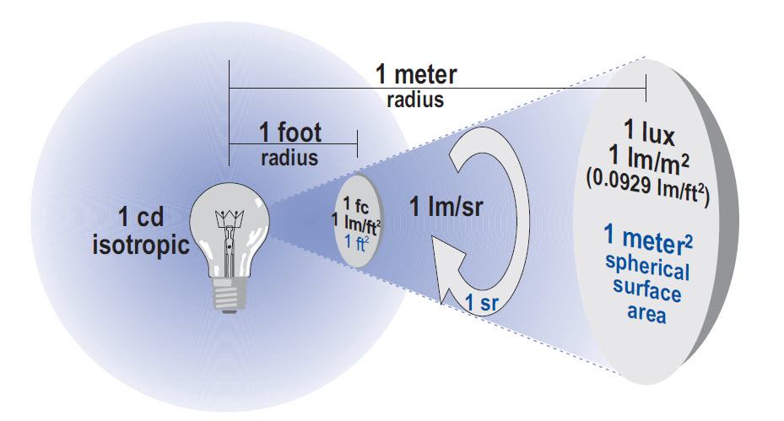
Lumens & Lux

Slide 12
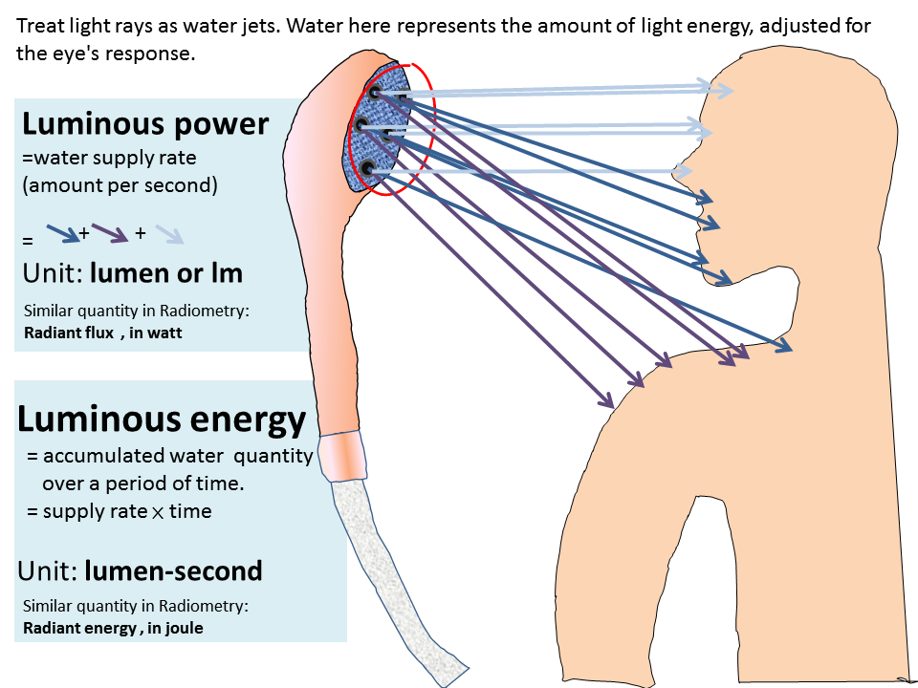
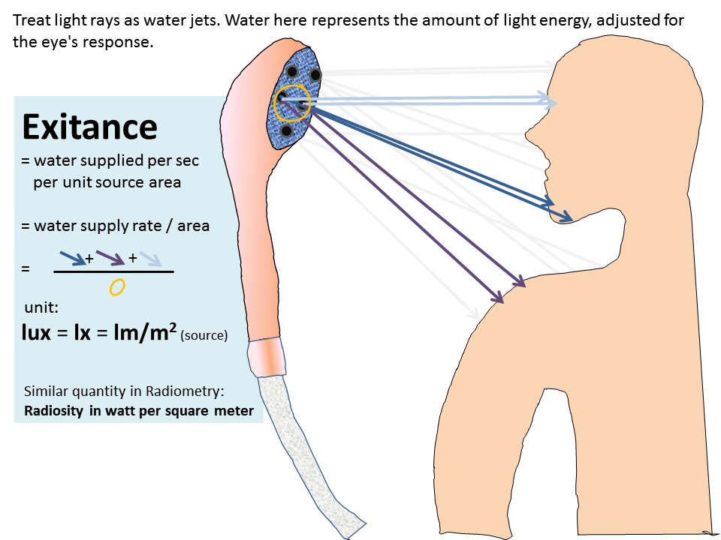

Slide 13
The Inverse Square Law
As a surface that is illuminated by a light source moves away from the light source, the surface appears dimmer. In fact, it becomes dimmer much faster than it moves away from the source. The inverse square law, which quantifies this effect, relates illuminance (E_{v}) and intensity (I_{v}) as follows:
E_{v} = I_{v}/d²
Where d = the distance from the light source.

Slide 14
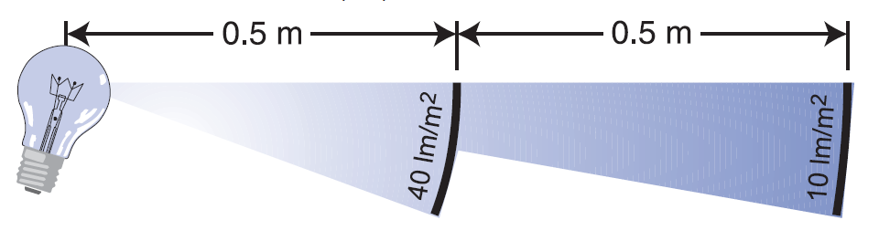
If the illuminance on a surface is 40 lux (lm/m²) at a distance of 0.5 meters from the light source, the illuminance decreases to 10 lux at a distance of 1 meter, as shown in the following figure.
Note: the inverse square law can only be used in cases where the light source approximates a point source. For lambertian light sources (“Lambertian Emission and Reflection”), a useful guideline to use for illuminance measurements is the “five times rule”: the distance from the measurement point to the light source should be greater than five times the largest dimension of the source for an accurate measurement. However, the five times rule does not work for a strongly directional light source. Think of a laser; does it adhere to E_{v}=I_{v}/d²

Slide 15
Optical Characteristics or Wrangling Light
Reflection
  Specular -mirror
  Spread – rough surface
  Diffuse – regular (matte) surface
  TIR – Total Internal Reflection
Refraction
  Change in the speed of light as it passes through different mediums
    Dispersion – wavelength effect on refraction
  Snell’s law
Transmission
  Index of refraction
  Filtering
Absorption
  Filters ie by wavelength (λ), selective absorption

Slide 16
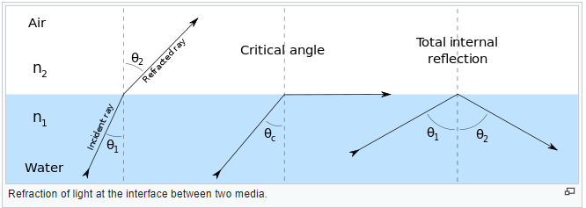
Refraction, Refraction, TIR (Total Internal Reflection)
If the reflecting surface is very smooth, the reflection of light that occurs is called specular or regular reflection. The laws of reflection are as follows:
The incident ray, the reflected ray and the normal to the reflection surface at the point of the incidence lie in the same plane.
The angle which the incident ray makes with the normal is equal to the angle which the reflected ray makes to the same normal.
The reflected ray and the incident ray are on the opposite sides of the normal.

Slide 17
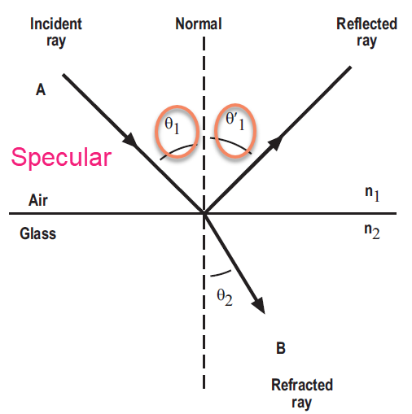
Snell’s law (simplified)
n₁sin Φ₁ = n₂sin Φ₂
Where n₁ = the refractive index of medium 1, n₂ = the refractive index of medium 2, Φ₁ = the incident angle of the light ray (with respect to the normal) Φ´₁ = the reflected angle (with respect to the normal) Φ₂ = the refracted angle (with respect to the normal)

Slide 18
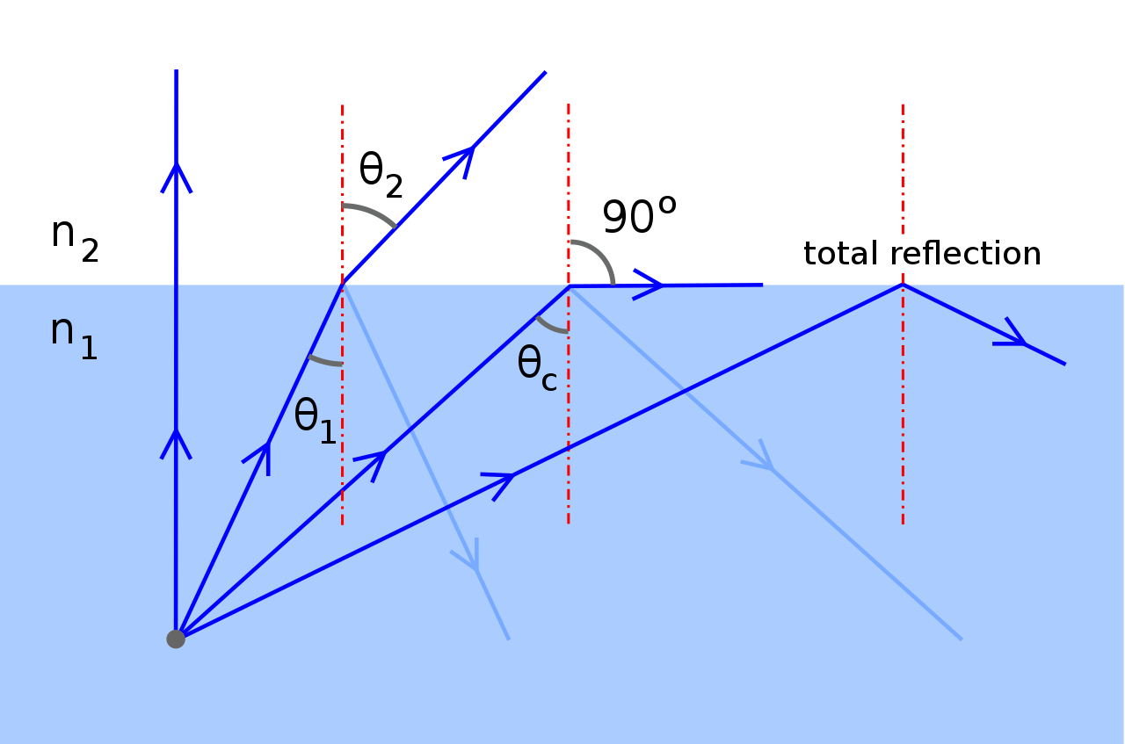
TIR (Total Internal Reflection)
Behavior of a ray incident from a medium of higher refractive index n₁ to a medium of lower refractive index n₂ , at increasing angles of incidence.^{[Note 2]}
Fig. 5 ought to show a fully reflected ray, and no tangential ray, for incidence at θ_{c}. But, due to diffraction, an incident beam of finite width cannot have a single angle of incidence; there must be some divergence of the beam. Moreover, the graph of the reflection coefficient vs. the angle of incidence becomes vertical at θ_{c} (Jenkins & White, 1976, p. 527), so that a small divergence of the beam causes a large loss of reflection. Similarly, near the critical angle, a small divergence in the angle of incidence causes a large divergence in the angle of refraction (cf. Huygens, 1690, tr. Thompson, p. 41); the tangential refracted ray should therefore be taken only as a limiting case.

Slide 19
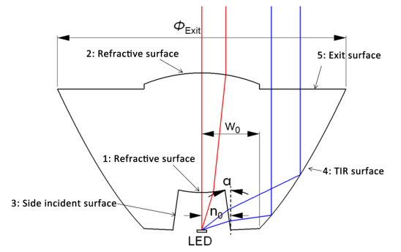
TIR Collimating Lens (Typically PMMA)
A sketch of a TIR lens. The lens is made up of two groups of surfaces. The starting points of the side incident surface and the TIR surface are n₀n₀ and w₀w₀, respectively. The tilt angle of the side incident surface is α, and the diameter of the exit pupil is Φ_{exit}. Rays emitted from different groups of surfaces are also plotted.
If only it were that simple!

Slide 20
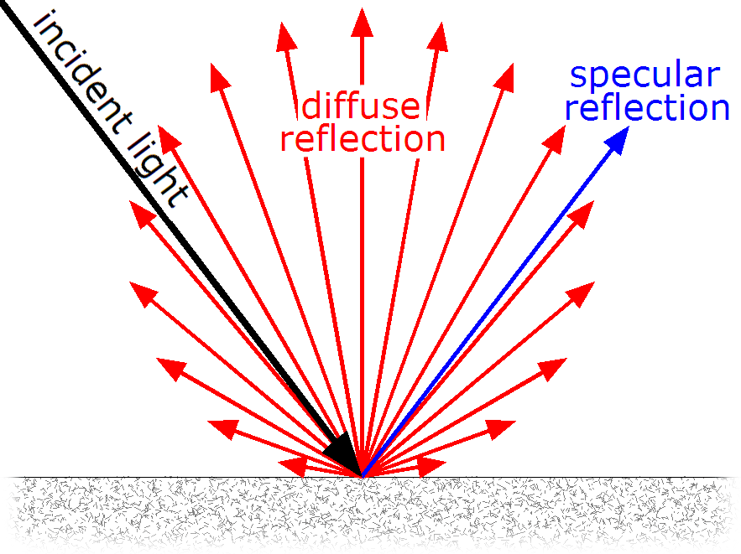
Diffuse reflection is the reflection of light or other waves or particles from a surface such that a ray incident on the surface is scattered at many angles rather than at just one angle as in the case of specular reflection. An ideal diffuse reflecting surface is said to exhibit Lambertian reflection, meaning that there is equal luminance when viewed from all directions lying in the half-space adjacent to the surface.

Slide 21
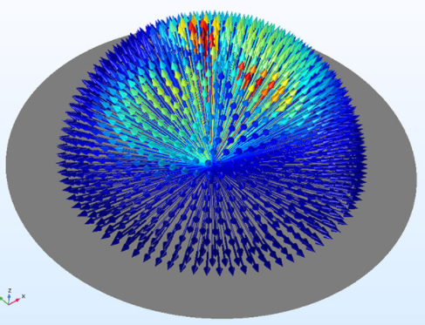
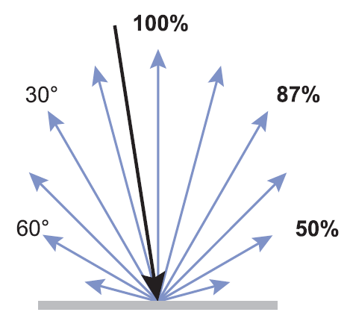
Lambertion Reflection (distribution)
In optics, Lambert's cosine law says that the radiant intensity or luminous intensity observed from an ideal diffusely reflecting surface or ideal diffuse radiator is directly proportional to the cosine of the angle θ between the direction of the incident light and the surface normal.^{[1][2]} The law is also known as the cosine emission law^{[3]} or Lambert's emission law. It is named after Johann Heinrich Lambert, from his Photometria, published in 1760.^{[4]}
https://en.wikipedia.org/wiki/Lambert%27s_cosine_law

Slide 22
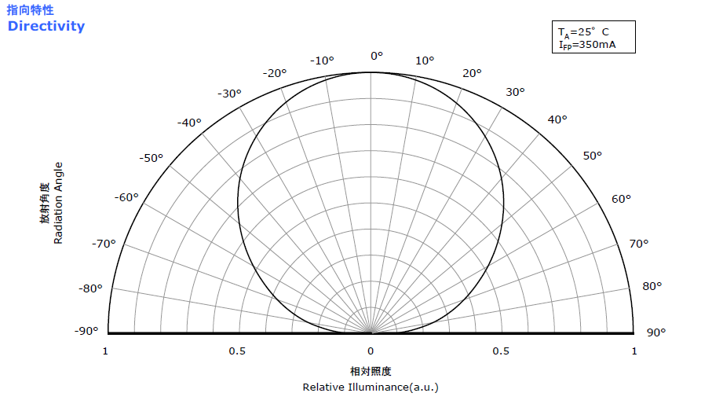
Nichia NCSW119BT-V1 LED

Slide 23
Fun Facts…
Brainpower
Although the average adult human brain weighs about 1.4 kilograms, only 2 percent of total body weight, it demands 20 percent of our resting metabolic rate (RMR)—the total amount of energy our bodies expend in one very lazy day of no activity. RMR varies from person to person depending on age, gender, size and health. If we assume an average resting metabolic rate of 1,300 calories, then the brain consumes 260 of those calories just to keep things in order. That's 10.8 calories every hour or 0.18 calories each minute. (For comparison's sake, see Harvard's table of calories burned during different activities). With a little math, we can convert that number into a measure of power:
—Resting metabolic rate: 1300 kilocalories, or kcal, the kind used in nutrition
—1,300 kcal over 24 hours = 54.16 kcal per hour = 15.04 gram calories per second
—15.04 gram calories/sec = 62.93 joules/sec = about 63 watts
—20 percent of 63 watts = 12.6 watts
So a typical adult human brain runs on around 12 watts—a fifth of the power required by a standard 60 watt lightbulb. Compared with most other organs, the brain is greedy; pitted against man-made electronics, it is astoundingly efficient. IBM's Watson, the supercomputer that defeated Jeopardy! champions, depends on ninety IBM Power 750 servers, each of which requires around one thousand watts.
https://www.scientificamerican.com/article/thinking-hard-calories/

Slide 24
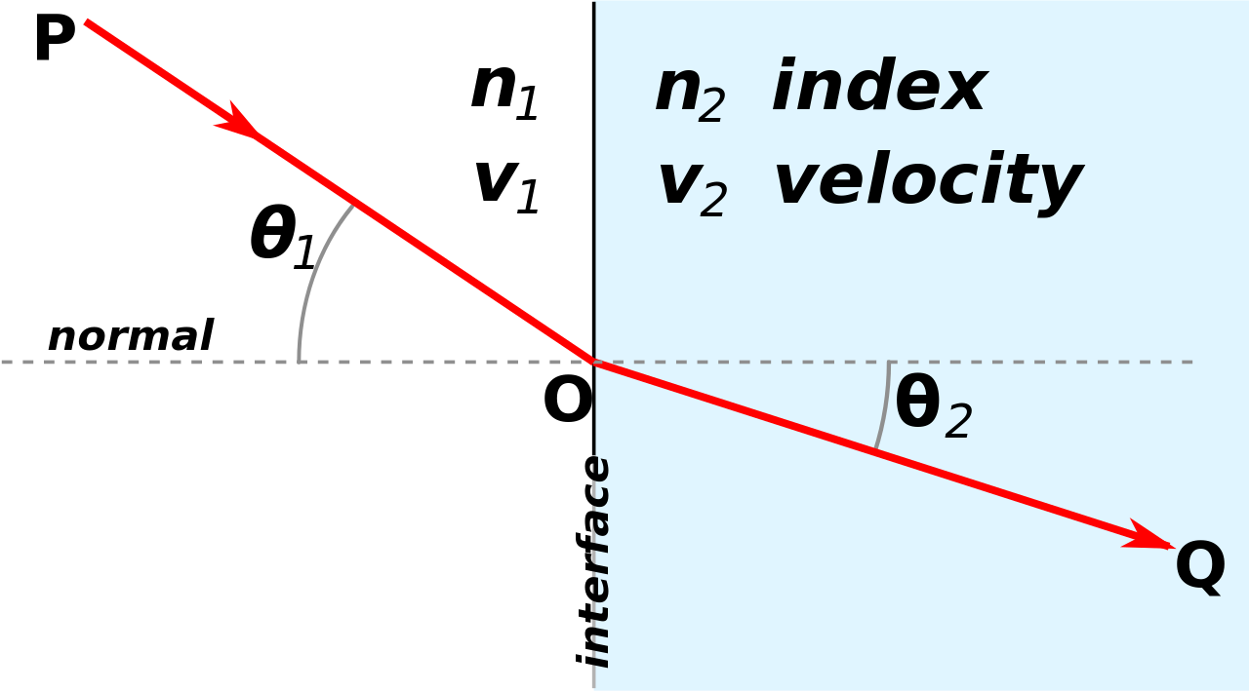
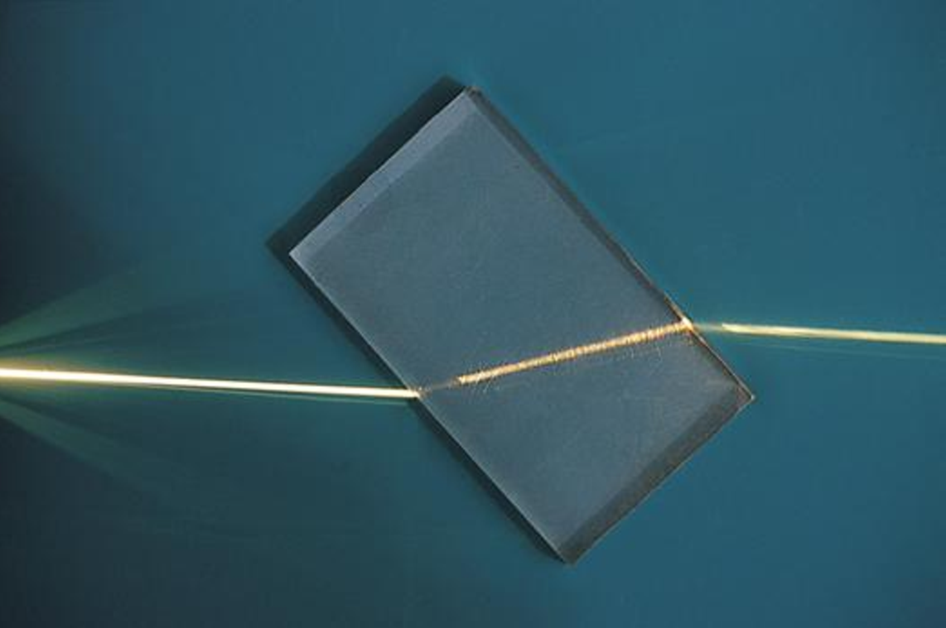
Refraction
For light, refraction follows Snell's law, which states that, for a given pair of media, the ratio of the sines of the angle of incidence θ₁ and angle of refraction θ₂ is equal to the ratio of phase velocities (v₁ / v₂) in the two media, or equivalently, to the indices of refraction (n₂ / n₁) of the two media.
Optical prisms and lenses use refraction to redirect light, as does the human eye. The refractive index of materials varies with the wavelength of light,^{[3]} and thus the angle of the refraction also varies correspondingly. This is called dispersion and causes prisms and rainbows to divide white light into its constituent spectral colors.

Slide 25


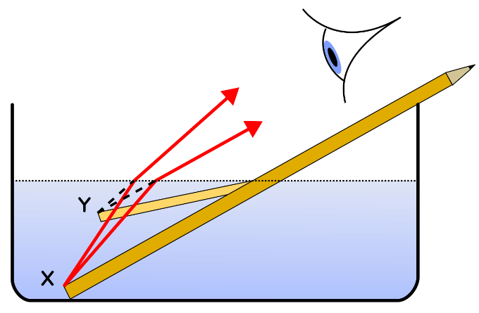
For light, the refractive index n of a material is more often used than the wave phase speed v in the material. They are, however, directly related through the speed of light in vacuum c as
In optics, therefore, the law of refraction is typically written as
The bent pencil in water phenomena: Water has an index of refraction of n=1.33 and air n~1

Slide 26
Refractive Index η (also referred to as Index of Refraction)
The Refractive Index of any tranmissive material varies with wavelength. Most optical materials refer to η @ 555nm. As white light is made up of many wavelengths each will refract at a different angle in a given material.
Some common values for η
Vacuum: 1.000
Air @STP: 1.000277
Poly(methyl methacrylate) (PMMA: 1.4893–1.4899
Polycarbonate: 1.586
Cornea: 1.376
ZEONEX: 1.53
Borosilicate glass: 1.51 – 1.54

Slide 27
Transmission
A simple definition of light transmission is: When light travels through a medium such as glass without being reflected absorbed or scattered.
Many material spec data sheets describe their optical transitivity as a percentage of total light that exits v enters. Or as a percentage loss of light as it passes through the material.
95% transmissivity = 5% opacity
A ray of light when entering a transmissive medium ie glass at an angle greater than the critical angle will see a loss of ~4% for each medium interface (surface). Thus a ray passing through a window in air with a 98% transmittance will incur an 8% loss (4% at entry surface and 4% at exit surface) plus 2% transmission loss.

Slide 28
Absorption
Since the energy levels of matter are quantized, only light of energy that can cause transitions from one existing energy level to another will be absorbed.
The absorbance of an object quantifies how much of the incident light is absorbed by it (instead of being reflected or refracted). This may be related to other properties of the object through the Beer–Lambert law.
Lambert’s law of absorption states that equal thicknesses of a given homogenous material absorb the same fraction of light. In other words, if a 1-cm block of material absorbs half of the incoming light, a second 1-cm block of the same material would again absorb half of the beam (as shown in Figure 2.7) , so that only 0.5 X 0.5, or 0.25, of the original light is transmitted through a total of 2 cm of material.

Slide 29
Absorption - Spectral
Vantablack is a material developed by Surrey NanoSystems in the United Kingdom and is one of the darkest substances known, absorbing up to 99.965% of visible light (at 663 nm if the light is perpendicular to the material).
MIT engineers have created a blackest black coating from carbon nanotubes that is reportedly 10 times darker than any material created before, including Vantablack.
The coating, which is made from vertically aligned carbon nanotubes (CNT) grown on chlorine-etched aluminium foil, can absorb 99.995 percent of visible light.

Slide 30
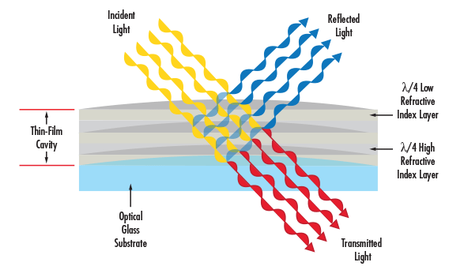
Filters
Optical Filters are used to selectively transmit or reject a wavelength or range of wavelengths.

Slide 31
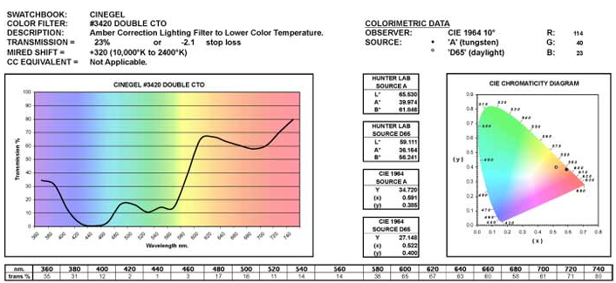

Filters and wavelength
This particular filter absorbs blue and green and transmits red.

Slide 32
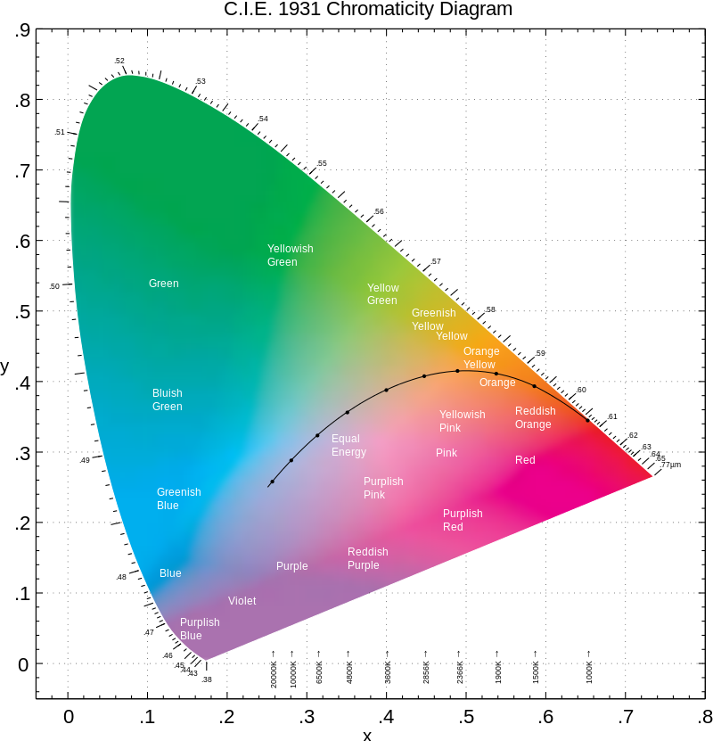
Coming up….
COLOR

